Slide 1
Stock Market Analysis Group-2 Mentors: Karthik and Dhanya
23/02/2023

Slide 2
Team members:
Mr. Rohith S
Mr. Akshay N R
Mr. Tharunesh Mahendiran
Mr. S. Dharshan Kumaar
Mr. Mohammed Saquib Ayubi
Mr. Aniruddha Bharat Dhokate
Ms. Snimy Stephen

Slide 3
Project Milestone:
Collection of data
EDA
Data visualisation
Preprocess the data
Partition Series
Applying Forecasting methods
Evaluate & compare performance
Forecasting for future 30 days and plot the output.
Deployment and Final presentation.

Slide 4

Business Problem:
In Stock market it is difficult for the traders to make a decision for which company he/she should invest based on the future value of stock to increase their Capital.
Objective:
The main aim of this project is to predict future stock prices of different companies/whether the trader should invest in a stock or not.

Slide 5
Data Extraction:
There are multiple platforms to extract data such as NSE,BSE,yahoo finance,nsepy library, etc.
We will be using yfinance(yahoo finance) library for our data extraction.
Steps: Install yfinance library >> Use history function to extract data.

Slide 6
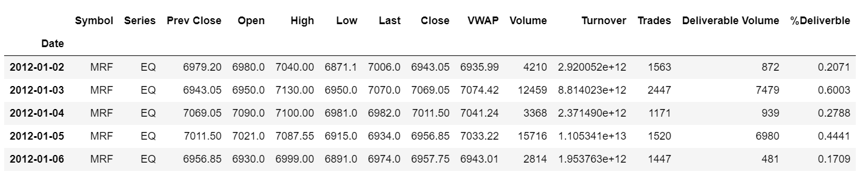
MRF Data

Slide 7
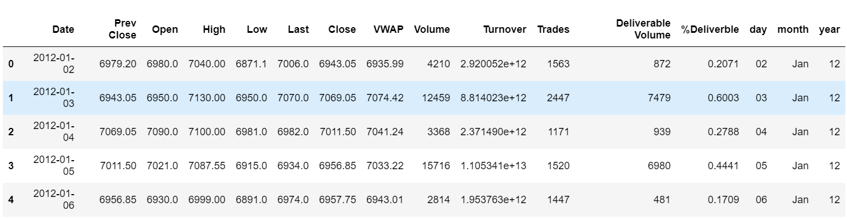
EDA
Date index has been converted to column.
Dropped columns ‘Series’ and ‘Symbol’.
Added new columns ‘Year’, ‘Month’ and ‘Day’ for visualisation purpose.

Slide 8

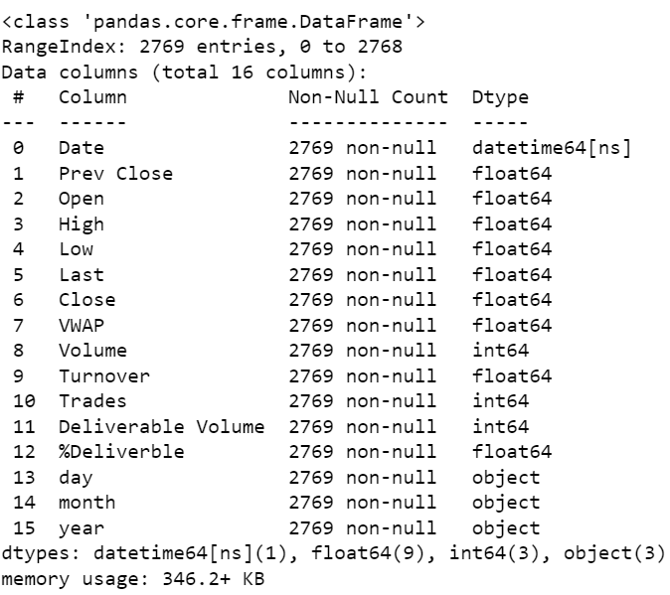
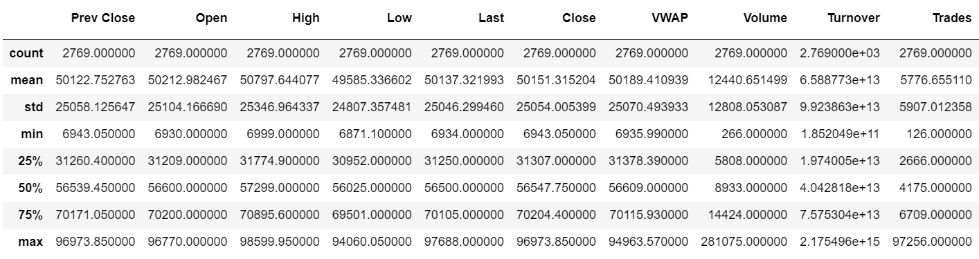
Data info and description:
There are no null values.
The highest price of the stock is Rs.98,599 while the lowest is Rs.6,871 .

Slide 9
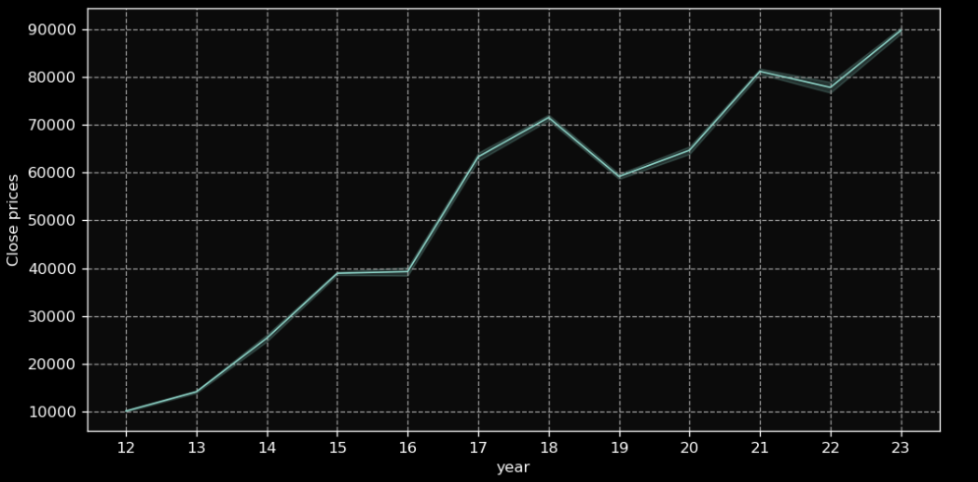
VISUALISATIONS
Line Plot:
Positive Trend
No seasonality

Slide 10
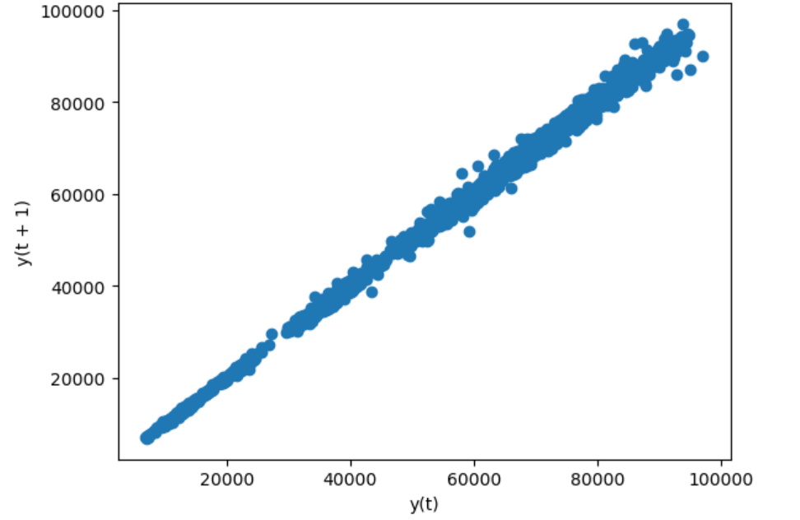
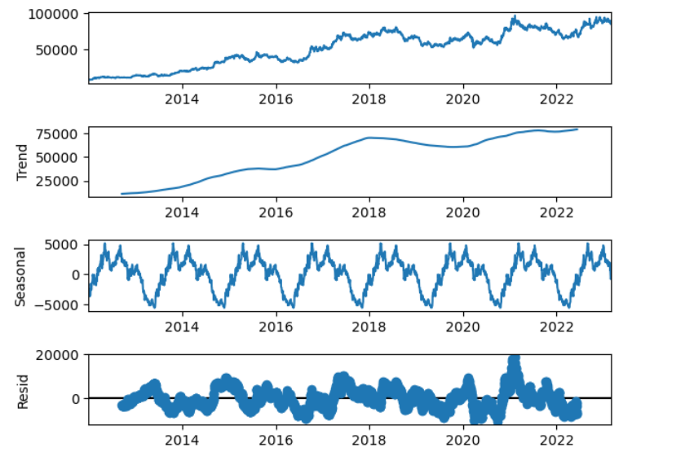
Other plots to see Trends and seasonality

Slide 11

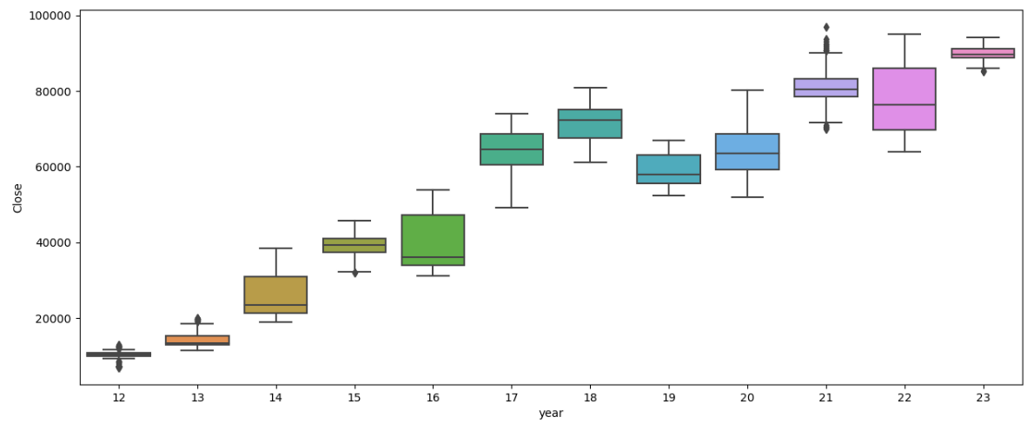
Box plot
Outliers found in the years 2012,2013 and 2021.
Most of the years the price is consistent without much variance.

Slide 12

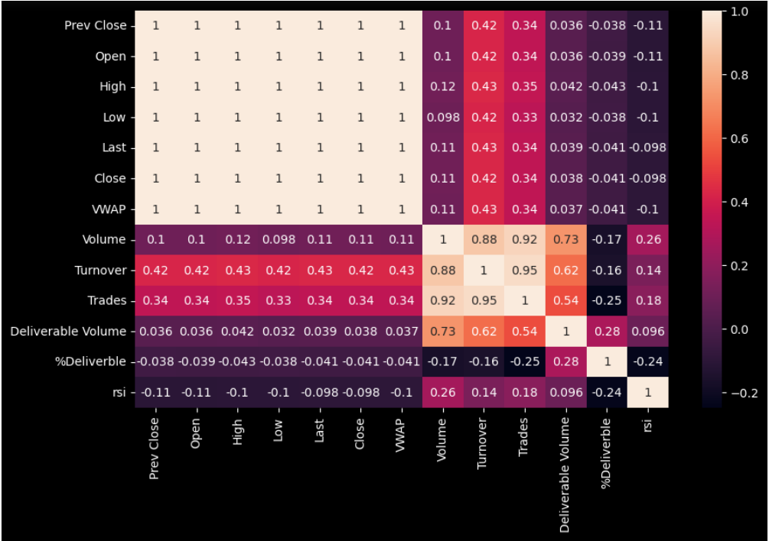
Heat Map
Volume , Turnover and Trades are highly correlated with each other.
Volume , Turnover and Trades are moderately correlated with deliverable Volume or vice versa.
Rest all are either least correlated or no correlation.

Slide 13

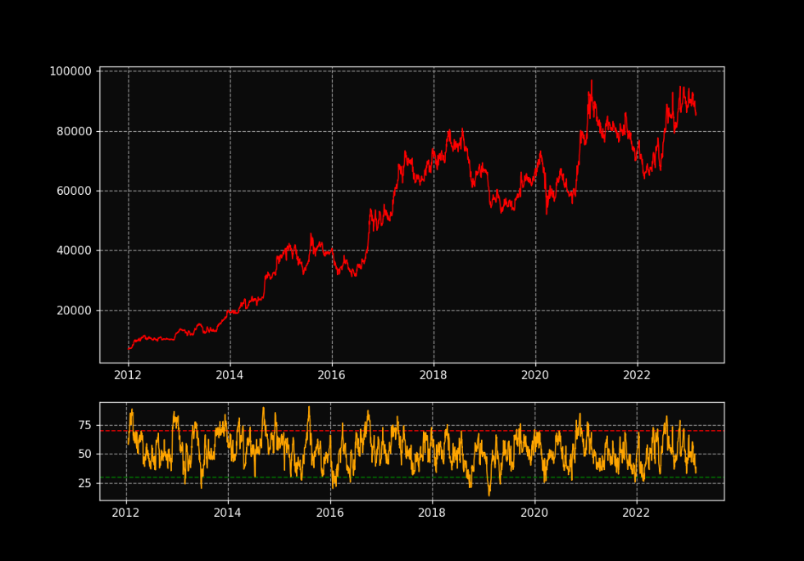
RSI plot to see over valued and under valued price.
This graph shows the right time to buy and sell the stocks.

Slide 14

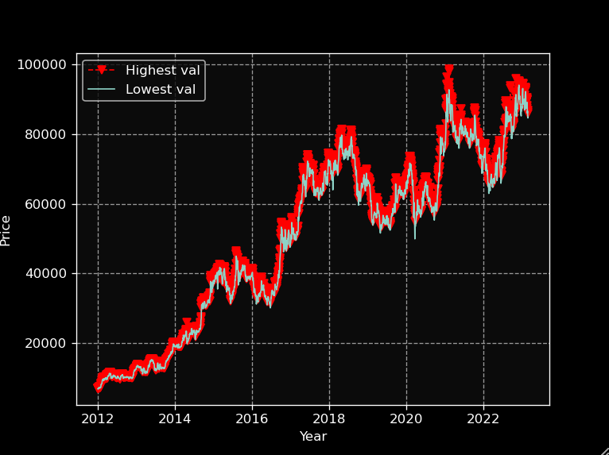
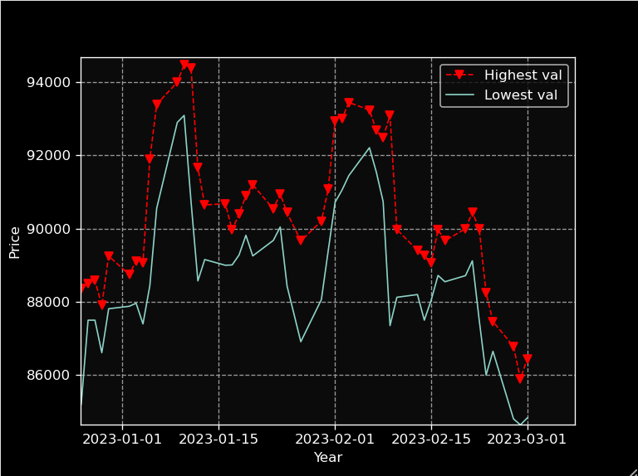
Line graph to compare high and low prices
Last 2 months comparison with better visualisation.

Slide 15

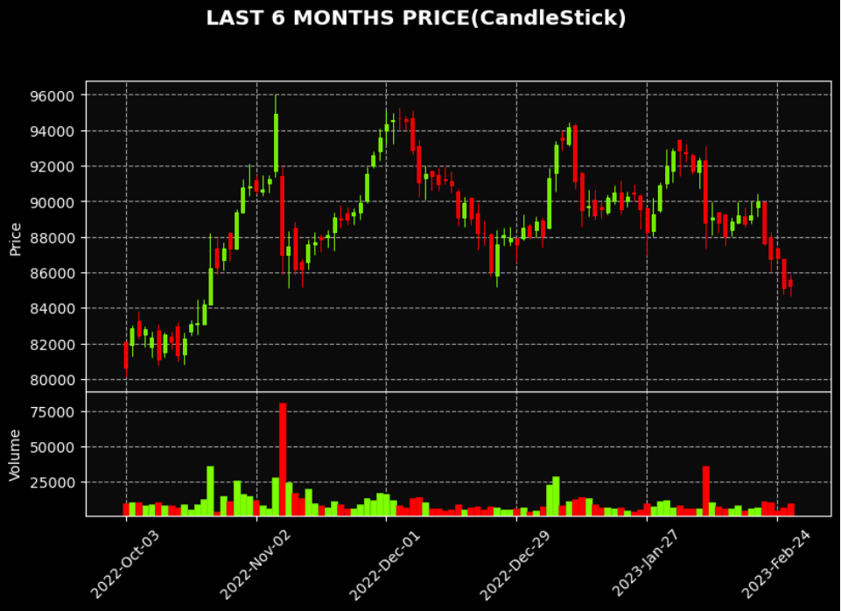
Candle Stick plot:
Candlestick patterns represent tendencies in price movement, not guarantees.
Patterns are separated into bullish and bearish.
Green sticks indicates that the price is likely to rise.
Red sticks indicates that the price is likely to fall.

Slide 16
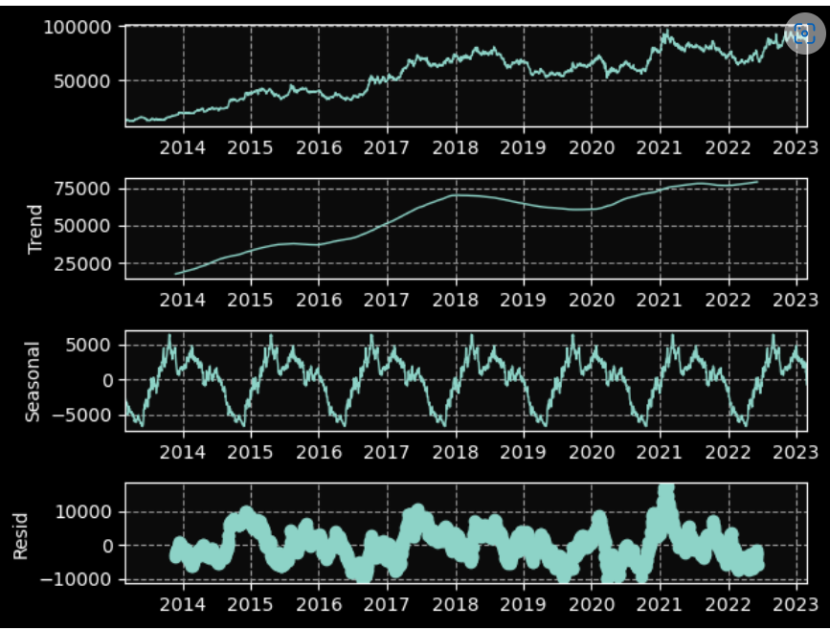
STATIONARY CHECK
By analysing data, we observe there is a significant trend and seasonality.
It shows that the data is non stationary.

Slide 17
TEST FOR STATIONARITY
ADF test is a statistical test used to find the stationary of the time series data.
Applying the test, we observe
p-value = 0.5510
p-value > α value (0.05) - NULL HYPOTHESIS – NOT STATIONARY
i.e. The data is not stationary

Slide 18
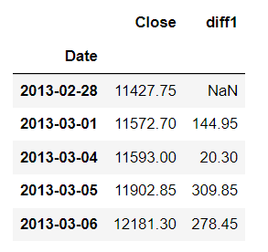
DIFFERENCING
By differencing we convert the non-stationary time series data to stationary.
We created new column named “ diff1” using the differencing technique implying (period=1)

Slide 19
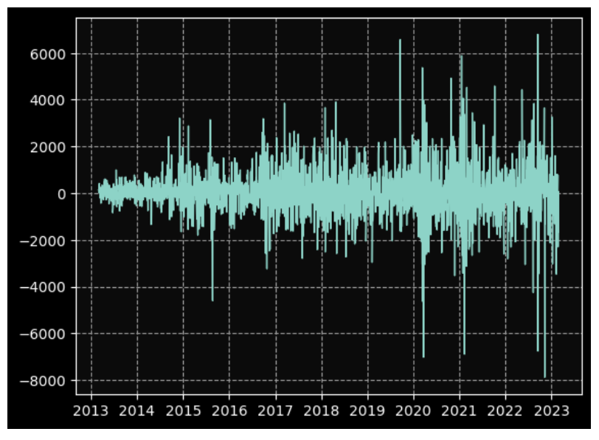
VISUALIZING THE diff1 COLUMN
By observing the plot, we can see the data has converted into stationary.

Slide 20
VERIFYING BY ADF TEST
Testing the diff column in ADF test.
By applying the ADF test, we got
p-value = 0.0
ie. p-value < α value (0.05) – REJECT NULL HYPOTHESIS - STATIONARY
Thus data has converted into stationary data

Slide 21
Models performed:
LSTM
ARIMA & SARIMAX
FbProphet
Holt’s Winter Model

Slide 22

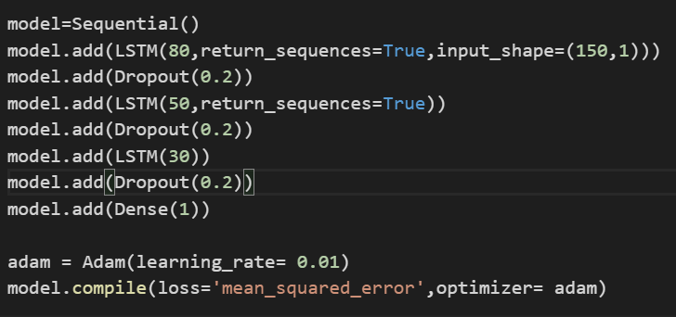
LSTM
No. of Neurons:80,50,30,1
Dropout rate=0.2
Learning_rate=0.01
Optimizer=Adam

Slide 23
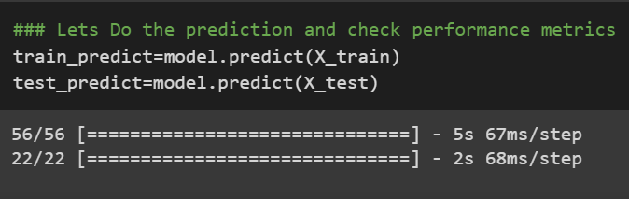
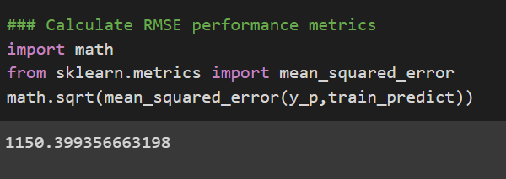
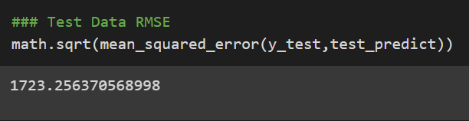
RMSE SCORE
RMSE Score of predicted Xtrain and ytrain is 1150.3993
RMSE Score of predicted Xtest and ytest s 1723.2563

Slide 24

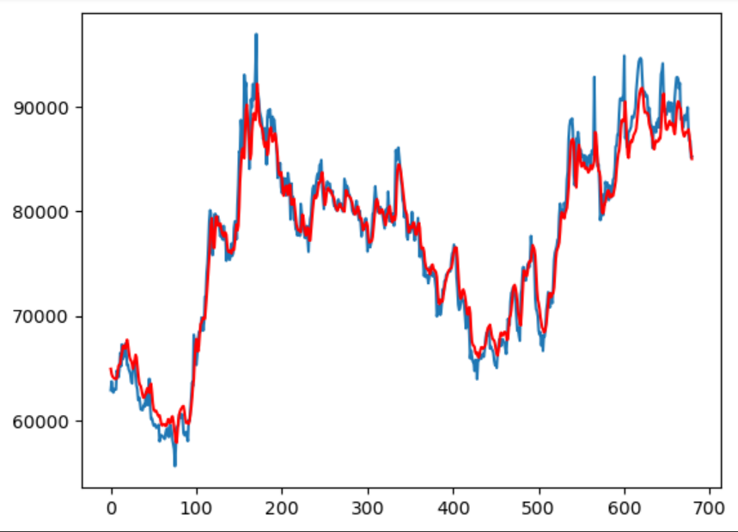
LINE PLOT OF PREDICTED XTEST AND YTEST
RED= Predicted
BLUE= Actual

Slide 25
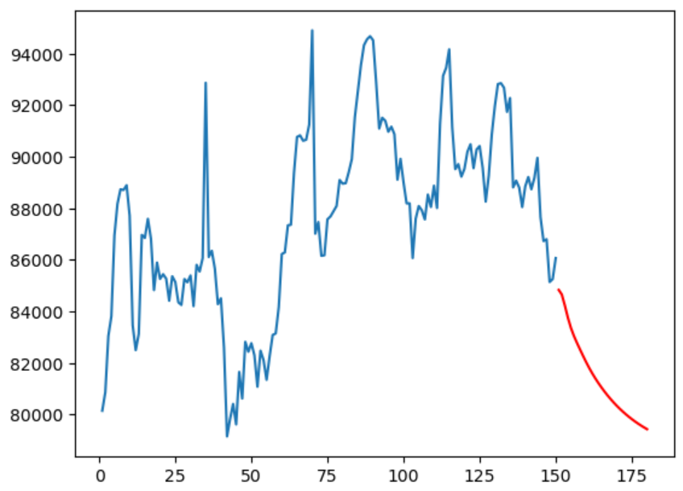
FORECASTED VALUES FOR 30 DAYS
BLUE line=
Actual values
RED line=
Forecasted values

Slide 26
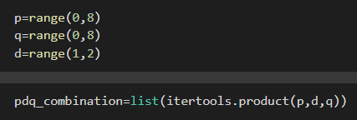
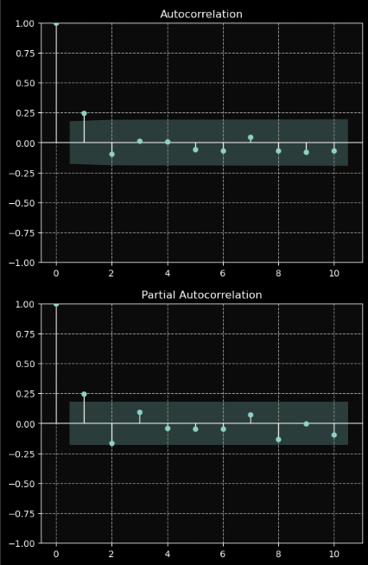
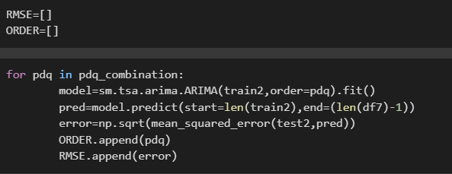
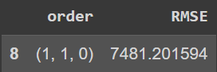
ARIMA
P and q values by using acf and pacf are (1,1) and by one step difference d=1
By iteration p,d,q values are (1,1,0)

Slide 27
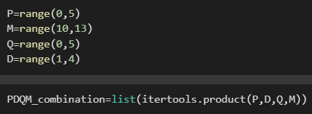
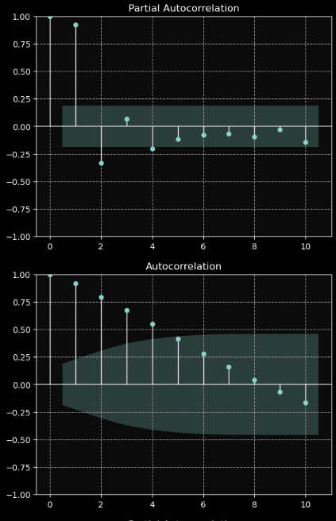
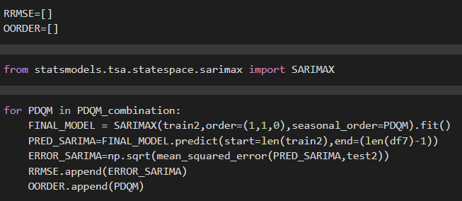
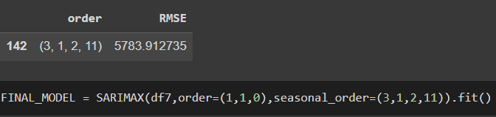
SARIMAX
P and q values by using
acf and pacf are (3,4)
and by one step
difference d=1
By iteration p,d,q,m
values are (3,1,2,11)

Slide 28
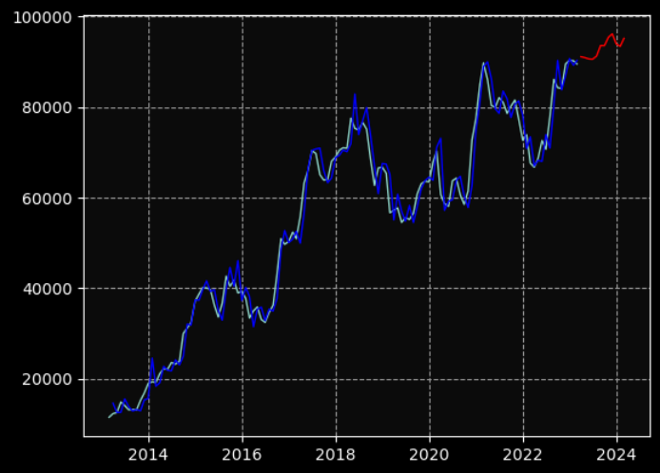
LINE PLOT FOR FORECASTED VALUES FOR 12 MONTHS
White line : Actual values
Dark Blue : predicted Actual values.
Red line : Forecasted values

Slide 29
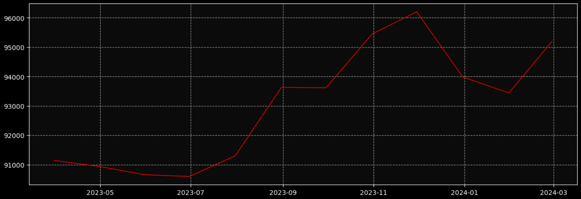
LINE PLOT FOR FORECASTED VALUES

Slide 30
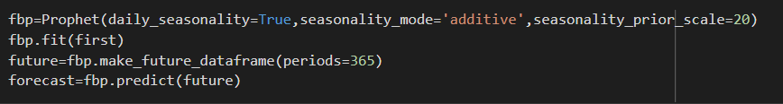
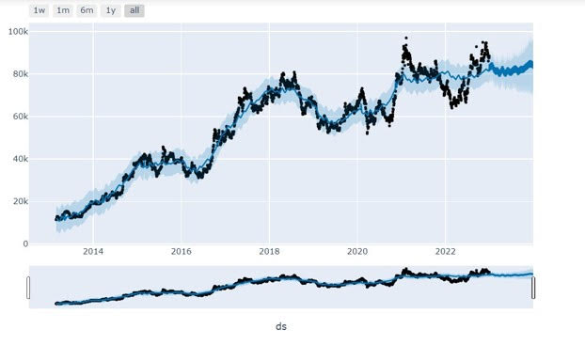
FbProphet

Slide 31
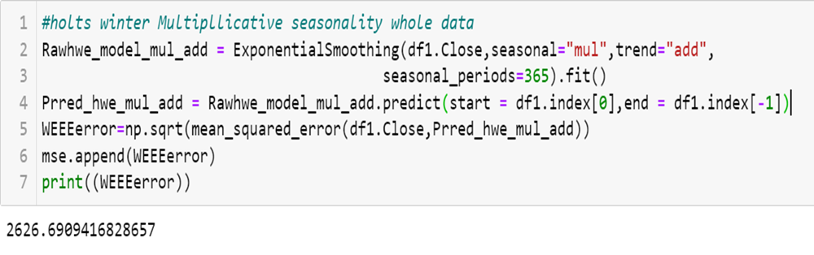
HOLT’S WINTER MODEL
Fitting the model on whole data which has multiplicative seasonality and additive trend.

Slide 32
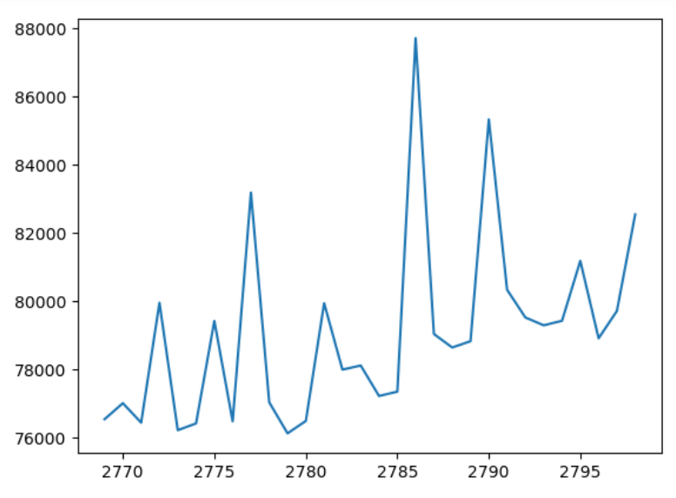
FORECASTED VALUES OF 30 DAYS

Slide 33
RMSE SCORES
LSTM - 1723.2563
SARIMAX – 5783.9127
FBPROPHET – 8781.6391
HOLTS WINTER – 2626.6909
LSTM model has the lowest RMSE score, hence we finalized it.

Slide 34
DEPLOYING MODEL
STREAMLIT
pip install streamlit
Free framework to build ML applications
Using Streamlit we can deploy our model in local host and visualize them precisely

Slide 35
CREATING H5 FILE.
Creating a H5file to load the model.
Copy and save the h5 file from jupyter notebook directory to a new folder .
Create a new python file in the same folder to proceed with the streamlit

Slide 36
DEPLOYMENT STEPS
Import streamlit
Load the model from keras
Loading the model will the reduce the time of fitting the model with train and test data

Slide 37
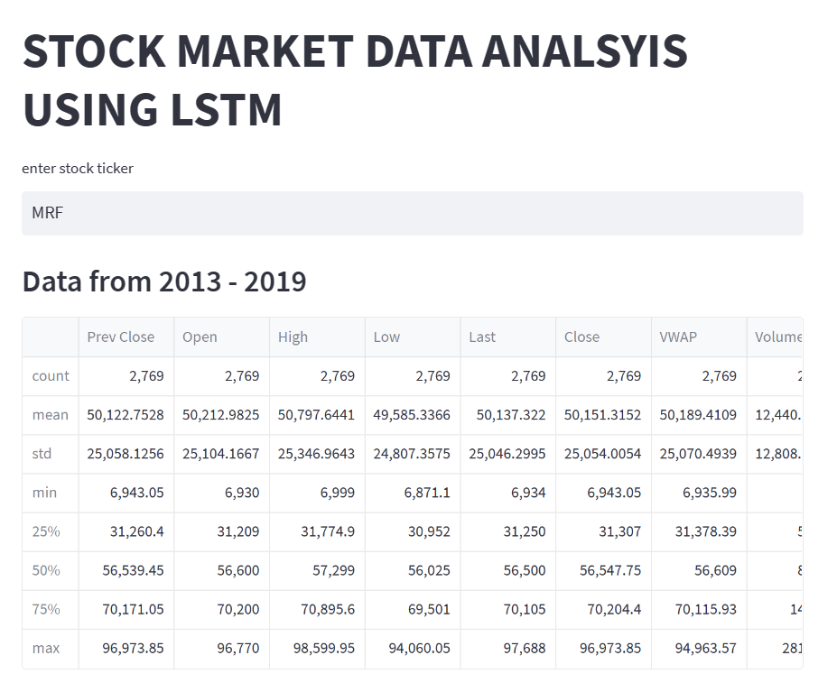
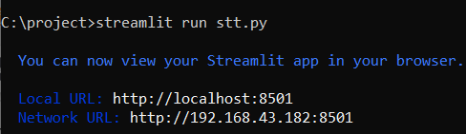
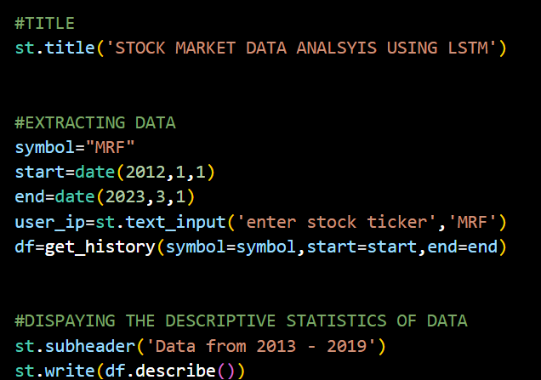
IMPORTING DATA AND DESCRIBE THE DATA
RUN THE STREAMLIT IN COMMAND PROMPT:

Slide 38
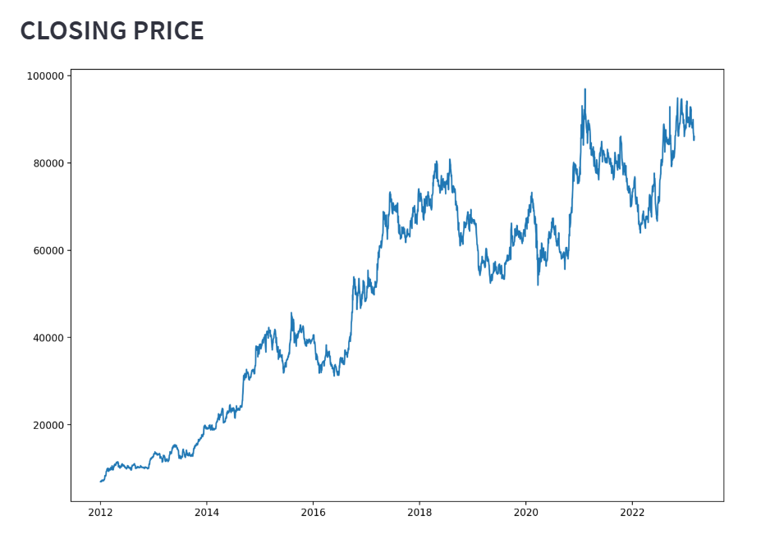
VISUALIZING THE CLOSING PRICE

Slide 39
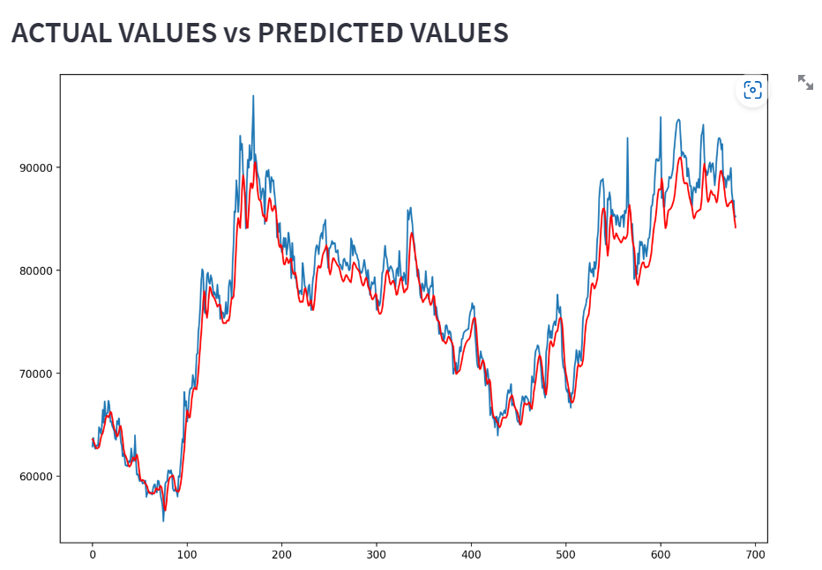
VISUALIZING THE ACTUAL VS PREDICTED VALUES

Slide 40
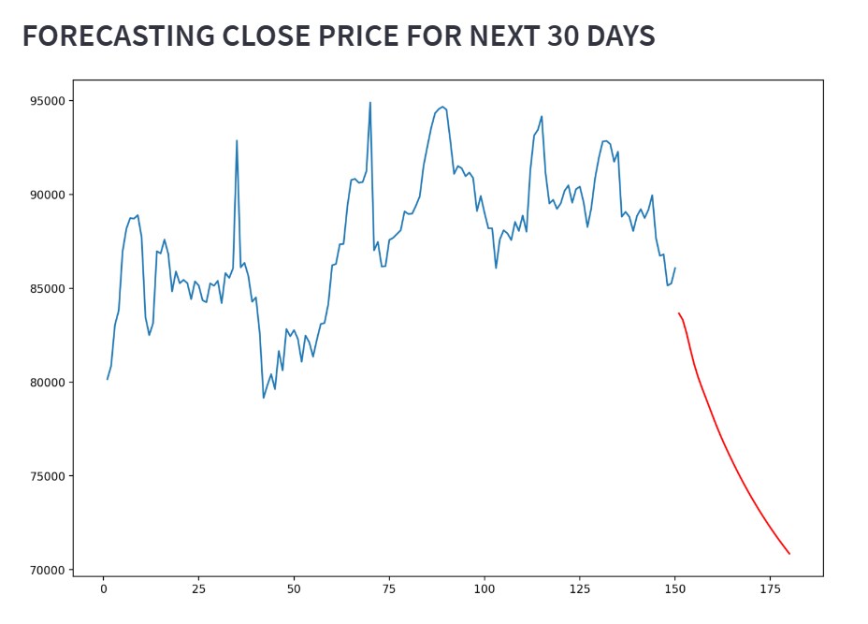
FORECASTING THE CLOSE PRICE FOR NEXT 30DAYS

Slide 41
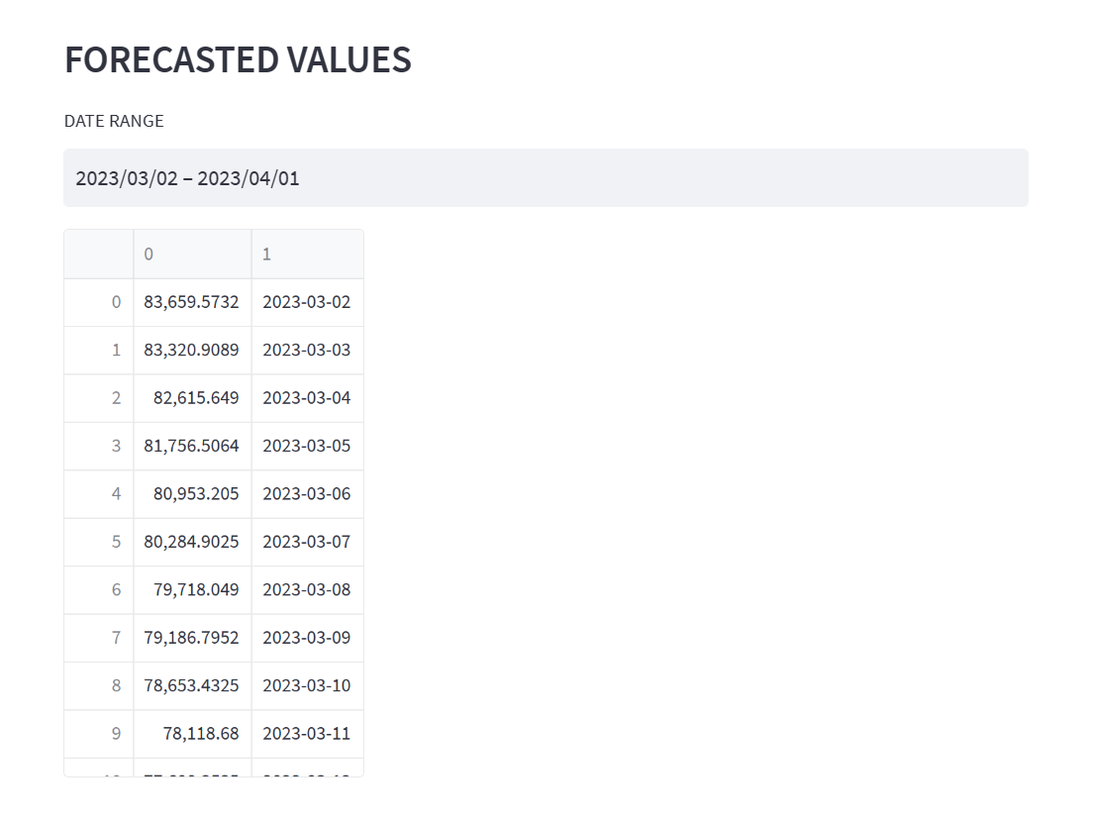
FORECASTED VALUES

Slide 42
CHALLENGES OVERCAME:
Challenges in selecting the models like arima, sarima, fbprophet, LSTM etc. we overcame it by selecting the lowest RMSE score.
Challenges while tuning hyperparameters in LSTM like droprate, epochs, neurons etc., we overcame it by trail and error method.
Challenges in fitting the data in the model while deploying, we used a HDF5 file formal to load the model and save the training time.
Challenges in displaying the forecasted close price and dates together, we overcame it by modifying the dimensionality of the array.

Slide 43
THANK YOU

